Slide 1

Unit-05 Usability Testing
UI/UX Designing (UI/UX)
DU # 2301CS622
Prof. Mayur Padia
Department of Computer Science & Engineering
mayur.padia@darshan.ac.in
99255 15118

Slide 2

Looping
Outline
Assessing Prototypes
Writing Good Heuristic Evaluations
Visibility of System Status
User Control and Freedom
Engagement Levels
Error Tolerance
Aesthetic and Minimalist Design
Planning and Conducting Usability Tests
Surveys and E-mail Surveys
Survey Tools
A/B Testing
UX Laws
Design Validation & Tradeoffs
Heatmaps with Tools like Hotjar

Slide 3
Assessing Prototypes
Section – 1

Slide 4
Accessing Prototypes
Assessing prototypes in usability testing involves observing how users interact with a design prototype to;
Identify potential usability issues
Gather feedback on key features
Evaluate the overall user experience
It allows for improvements to be made before final development.

Slide 5
Accessing Prototypes (contd.)
Testing Aspect | Explanation
Learnability | How easily users can understand and begin using the prototype without prior training.
Efficiency | Once familiar, how quickly and smoothly users can complete tasks within the prototype.
Memorability | How well users can remember key features and navigation paths when returning to the prototype after a period of time.
Error Rate | How often users make mistakes while interacting with the prototype, and how easily they can recover from errors.
User Satisfaction | Users' overall positive feelings and perception of their experience using the prototype.

Slide 6
Methods for Accessing Prototypes
Method | Description
Task-based testing | Provide users with specific tasks to complete within the prototype and observe their actions, noting any difficulties or confusion.
Think-aloud protocol | Ask users to verbalize their thoughts and reasoning while interacting with the prototype, providing insight into their decision-making process.
User interviews | Conduct structured or unstructured interviews with users after testing to gather qualitative feedback on their experience.
Heuristic analysis | Evaluate the prototype against established usability principles to identify potential issues.
Card sorting | Present users with a set of features or content cards and ask them to categorize them, revealing how they mentally organize information.
Method | Description
Task-based testing | Provide users with specific tasks to complete within the prototype and observe their actions, noting any difficulties or confusion.
Think-aloud protocol | Ask users to verbalize their thoughts and reasoning while interacting with the prototype, providing insight into their decision-making process.
User interviews | Conduct structured or unstructured interviews with users after testing to gather qualitative feedback on their experience.
Heuristic analysis | Evaluate the prototype against established usability principles to identify potential issues.
Card sorting | Present users with a set of features or content cards and ask them to categorize them, revealing how they mentally organize information.

Slide 7
Writing Good Heuristic Evaluations
Section - 2

Slide 8
Heuristic Evaluation
A heuristic evaluation is a method for identifying design problems in a user interface.
Evaluators judge the design against a set of guidelines (called heuristics) that make systems easy to use.
Choosing a Set of Heuristics - Assess usability, use Jakob Nielsen’s 10 usability heuristics guidelines based on an understanding of human behavior, psychology, and information processing.

Slide 9
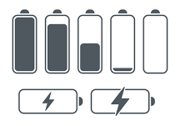

Visibility of System Status
It is communicating the current state allows users to feel in control of the system.
They can take appropriate actions to reach their goal, and ultimately trust the brand.
In most cases, more information translates to better decision making.
E.g.,
Your phone or laptop display how much battery life remains.
Your email application tells you how many unread emails you have.
A sign in the metro indicates the next stop.
Systems should always keep users informed about what is going on, through appropriate feedback within reasonable time.
Providing immediate feedback for interactive events allows users to quickly identify the source of errors and fix them as soon as they were made.
Sites and apps should clearly communicate to users what the system’s state is.

Slide 10
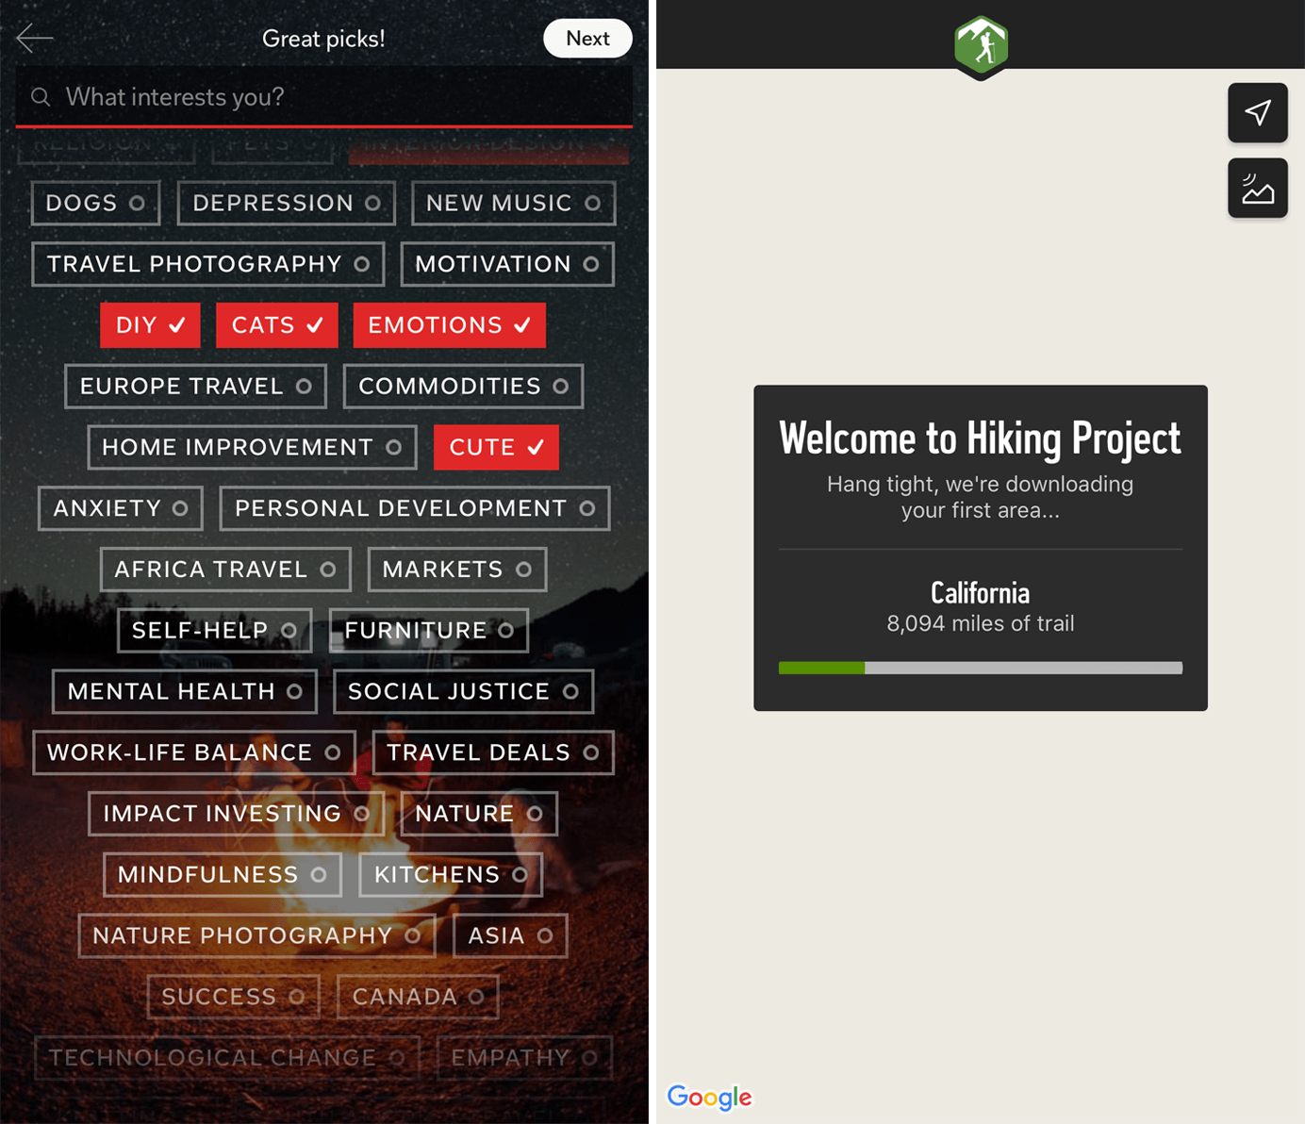
Visibility of System Status

Slide 11
User Control and Freedom
Users often make mistakes or change their minds.
Allow them to exit a flow or undo their last action and go back to the system’s previous state.
Heuristics - Users often choose system functions by mistake and will need a clearly marked “emergency exit” to leave the unwanted state without having to go through an extended dialogue.
Support undo and redo.
Users should be able to quickly correct mistakes or backtrack on choices made.
The ability to easily get out of trouble encourages exploration,
It facilitates learning and discovery of features.
It also increases overall use and sales.
Several UI controls that typically allow people to go back to the previous state of the system:
A Back link which returns users to a previous page or screen
A Cancel link which allows the user to quit a task or multi-step process
A Close link which allows users to close a new view
An Undo option to allow users to backtrack on a change to a UI element

Slide 12
Activity
Identify at least three instances where the product provides user control and freedom.
Identify at least two usability issues where users might feel trapped or lack an option to undo an action.

Slide 13
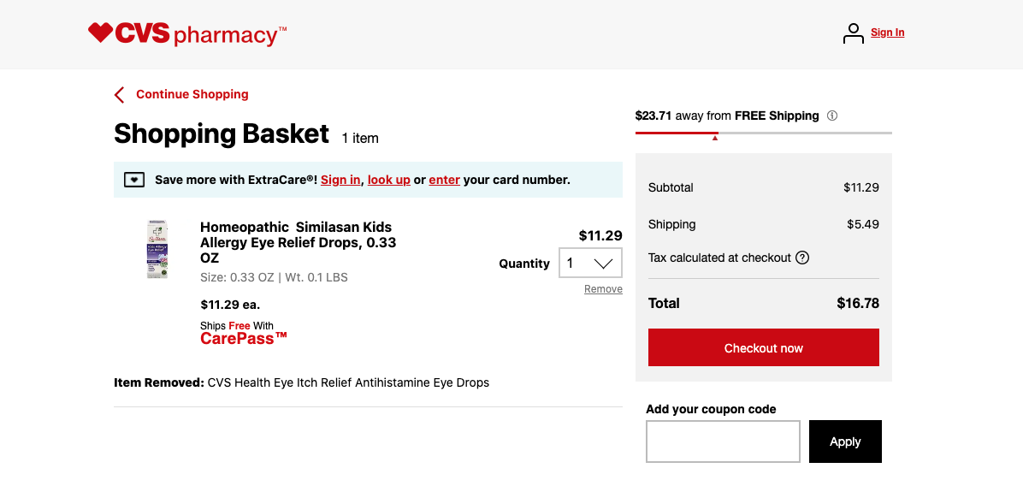
User Control and Freedom (contd.)

Slide 14
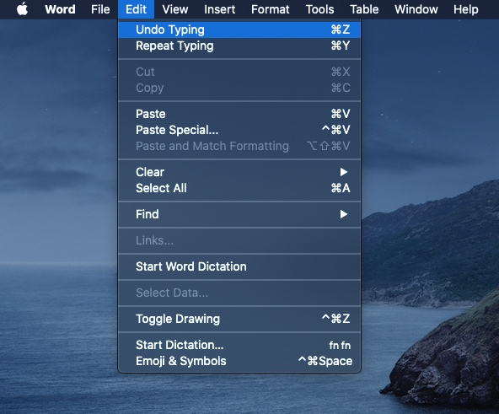
User Control and Freedom (contd.)

Slide 15
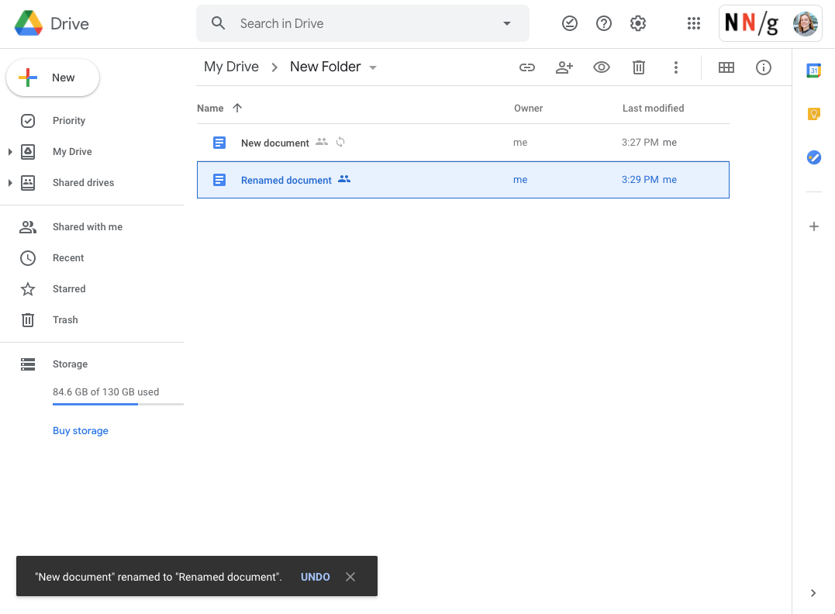
User Control and Freedom (contd.)

Slide 16
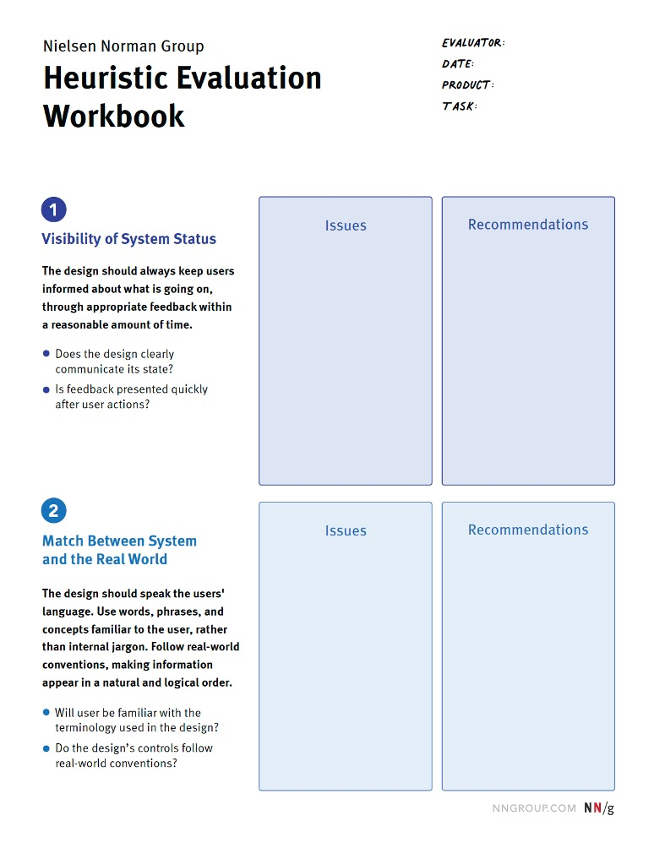
Steps to conduct heuristic evaluation
Choose and Train Your Team - three to five people should independently evaluate
Decide How to Document Evaluations
Heuristic-evaluation workbook
Spreadsheet
Digital whiteboard – Miro or Mural
Evaluate Independently
Become Familiar with the Product
Look for Issues
Merge Identified Issues

Slide 17
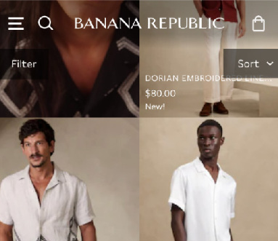

Heuristic Evaluation - Example
8
Aesthetic and minimalist design
Issues
Recommendations
Text overlaps with product images on listing pages
Improve product detail visibility maybe add a solid or semi-opaque background behind text

Slide 18

Heuristic Evaluation – Example (contd.)

Slide 19
Engagement Levels
Engagement levels in usability testing refers to the degree of active participation and interest a user demonstrates while interacting with a product or interface during a test.
It essentially measures how "involved" or "focused" they are throughout the task.
Engagement levels can be assessed during the testing session through qualitative observations like;
Facial expressions
Verbal cues
Overall behavior

Slide 20
Usability Testing
Section - 3

Slide 21
#Define
“A usability test evaluates an interface under real-world or controlled conditions.”

Slide 22
Usability Study
A usability study is a research method that assesses how easy it is for participants to complete core tasks in a design.
During a usability study, researchers follow participants as they interact with the product.
The user's feedback helps the design team make important improvements to the user experience.
Usability studies can take place at various points in the design process:
A usability study when you have an early idea
When you have an interactive prototype
A usability study with a product that is complete

Slide 23
Usability Study
In a usability-testing session, a researcher (called a “facilitator” or a “moderator”) asks a participant to perform tasks, usually using one or more specific user interfaces.
The participant completes each task, the researcher observes the participant’s behavior and listens for feedback.
The core elements in most usability tests are the facilitator, the tasks, and the participant.
The goals of usability testing usually includes:
Identifying problems in the design of the product or service
Uncovering opportunities to improve
Learning about the target user’s behavior and preferences

Slide 24
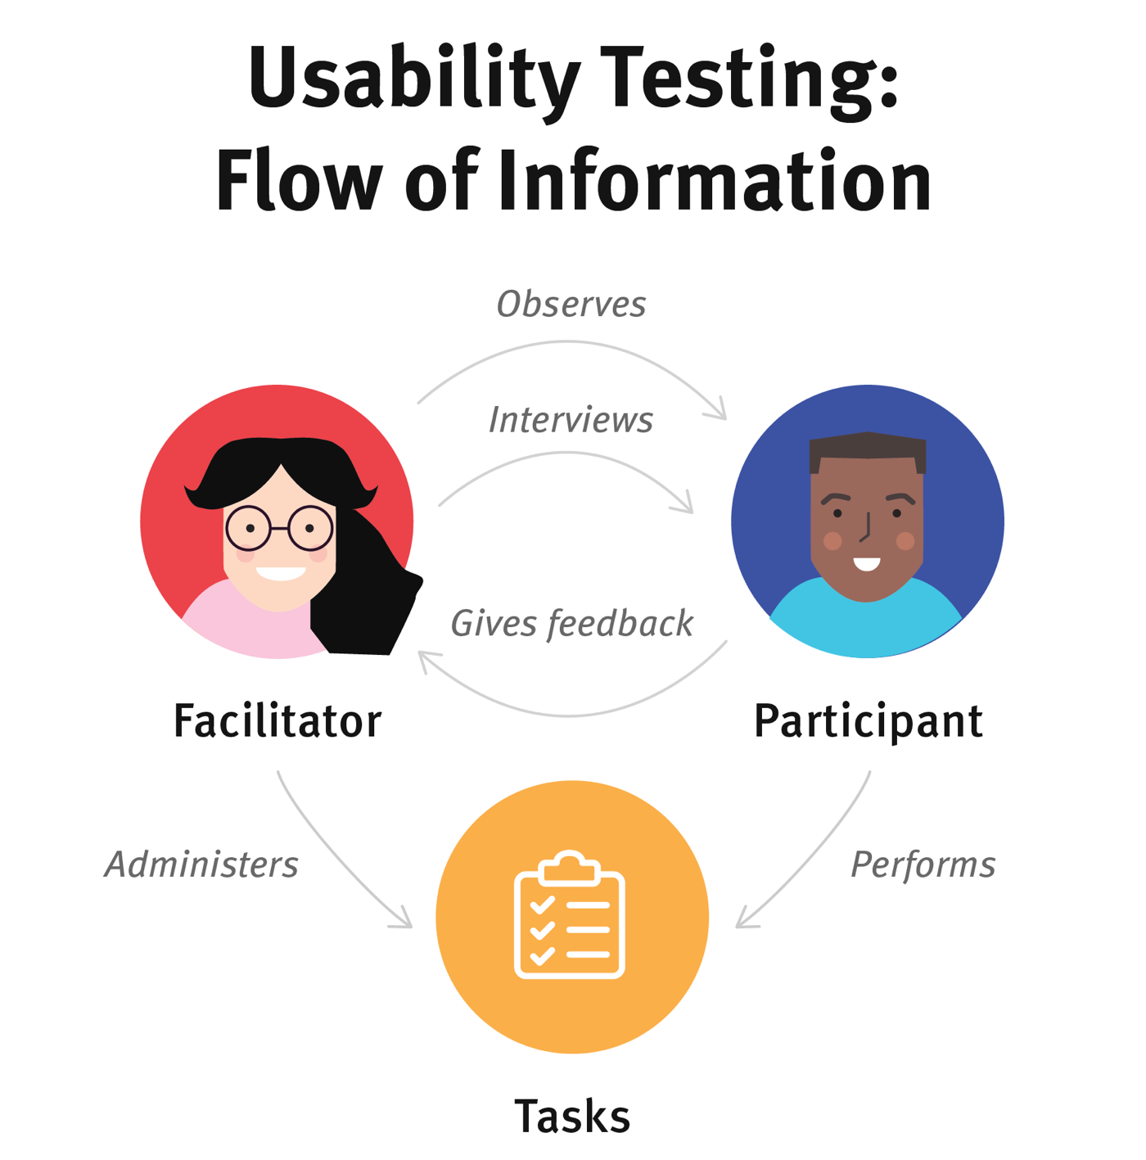
Usability Testing: Flow of Information
The facilitator administers tasks to the participant.
The participant performs the tasks, the facilitator observes the participant’s behavior and listens for feedback.
The facilitator may also ask follow up questions to draws out detail from the participant.

Slide 25
Qualitative vs. Quantitative
Qualitative Usability Testing
Qualitative usability testing focuses on collecting insights, findings, and stories about how people use the product or service.
Qualitative usability testing is best for discovering problems in the user experience.
This form of usability testing is more common than quantitative usability testing.
Quantitative usability testing
Quantitative usability testing focuses on collecting metrics like task success and time on task.
Quantitative usability testing is best for collecting benchmarks.

Slide 26
Remote vs. In-Person Testing
Remote usability tests are popular because they often require less time and money than in-person studies.
There are two types of remote usability testing: moderated and unmoderated.
Remote moderated usability tests work very similarly to in-person studies.
The facilitator still interacts with the participant and asks him/her to perform tasks.
The facilitator and participant are in different physical locations.
Moderated tests can be performed using screen-sharing software like Skype or Google Meet.

Slide 27
Remote vs. In-Person Testing
Remote unmoderated remote usability tests do not have the same facilitator–participant interaction as an in-person or moderated tests.
The researcher uses a dedicated online remote-testing tool to set up written tasks for the participant.
The participant completes those tasks alone on her own time.
The testing tool delivers the task instructions and any follow up questions.
After the participant completes her test, the researcher receives a recording of the session, along with metrics like task success.

Slide 28
Benefits of Usability Test
It helps to check if product meet user’s expectations
It matches business decisions to real-world use
It removes flaws in the product
It allows you to see how successful users are with their tasks
It is useful for getting user reactions and feedback about the product

Slide 29
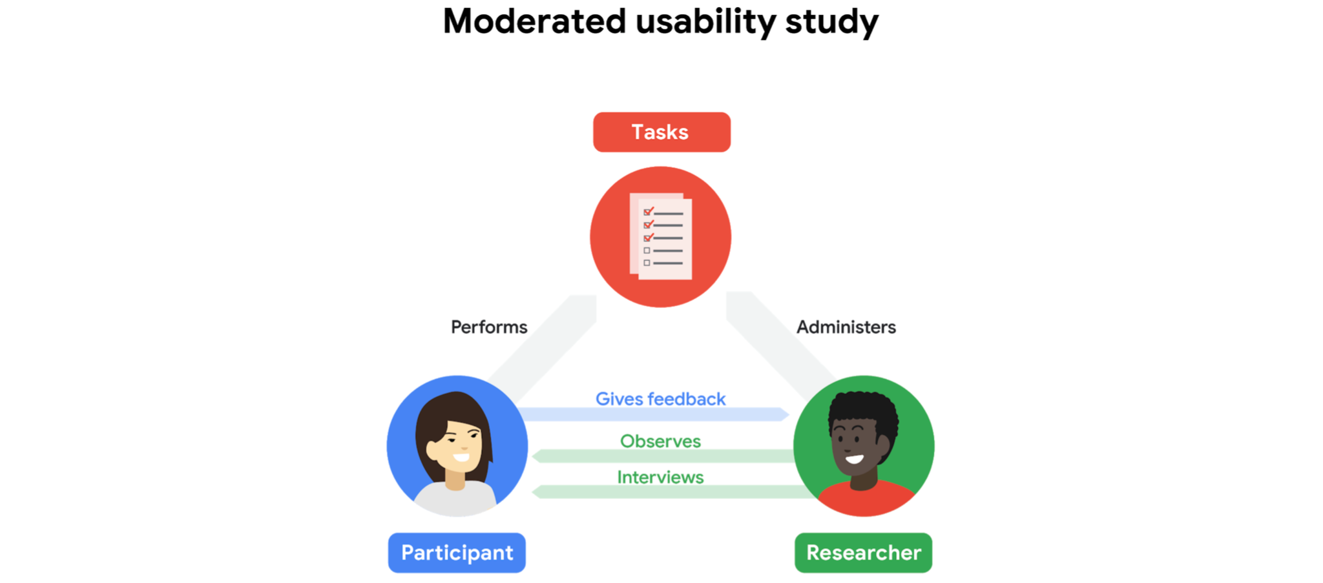
Types of Usability Study
Moderated Usability Study
In moderated usability studies, a person guides participants through the study in real time.
The person who guides participants through this study is known as the moderator.
The moderator's goal is to help participants interact with the product and collect their feedback along the way.

Slide 30
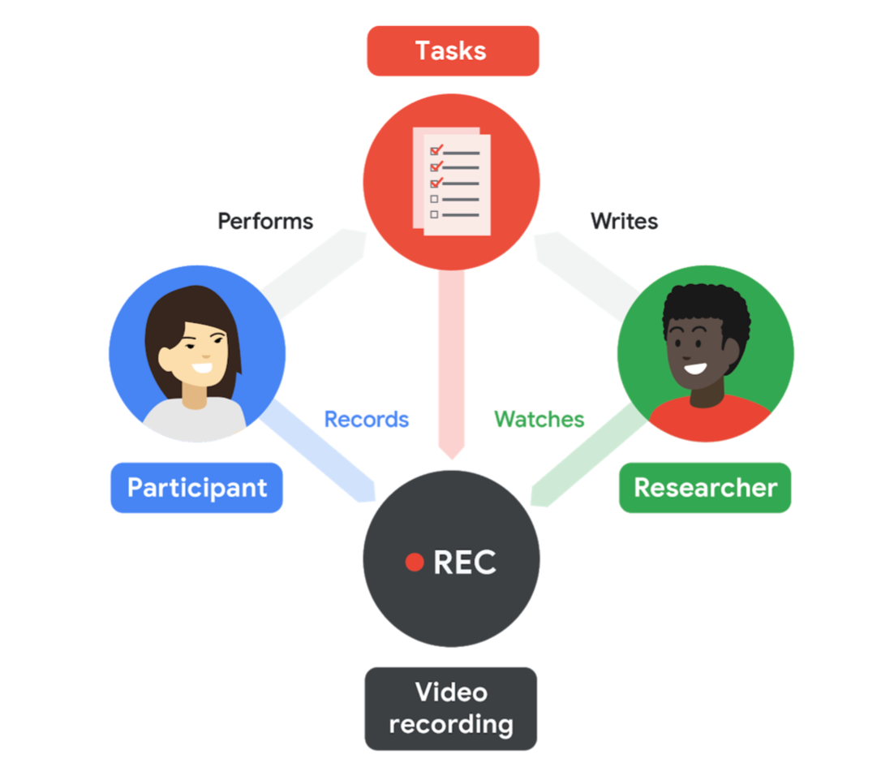
Types of Usability Study
Unmoderated Usability Study
In unmoderated usability studies, participants test out the prototypes without human guidance.
The study is recorded on video and the UX team reviews the video footage after the study.
Unmoderated usability studies do not have a designated moderator.

Slide 31
Usability Study – Benefits and Limitations
Study Type | Benefits | Limitations
Moderated Usability Study | Guides the participant through the study Ask specific questions and follow up in real time to learn more. Rapport building between the moderator and participant | The moderator could influence the participants.
Unmoderated Usability Study | Easier to see how a participant uses the product in the real world. Participants to complete tasks on their own time and in their own space Participants may feel more comfortable giving feedback without others around. | Participants have no human guidance if issue arises No real-time follow-up questions Little to no control over the environment

Slide 32
Survey Tools
When conducting usability testing, popular survey tools include
UserTesting
Hotjar
UserZoom
Lookback
UsabilityHub
These platforms allow you to gather qualitative feedback from users through surveys.
They often provide features like session recordings and heatmaps to analyse user interactions on your website or app.

Slide 33
Survey Tools (contd.)
Tool | Description
UserTesting | A platform for both moderated and unmoderated testing. It allows you to collect qualitative feedback from users.
Hotjar | Provides heatmaps, user recordings, and survey capabilities to understand how users interact with your website or app.
UserZoom | Offers a large participant pool and robust features for conducting large-scale usability tests.
Lookback | Focuses on qualitative research with features like screen recording and facial expressions to capture user reactions during testing.
UsabilityHub | A popular tool for quickly collecting qualitative and quantitative feedback through usability tests.

Slide 34
#Define
“A/B testing is a methodology for comparing two versions of a webpage or app against each other to determine which one performs better.”

Slide 35
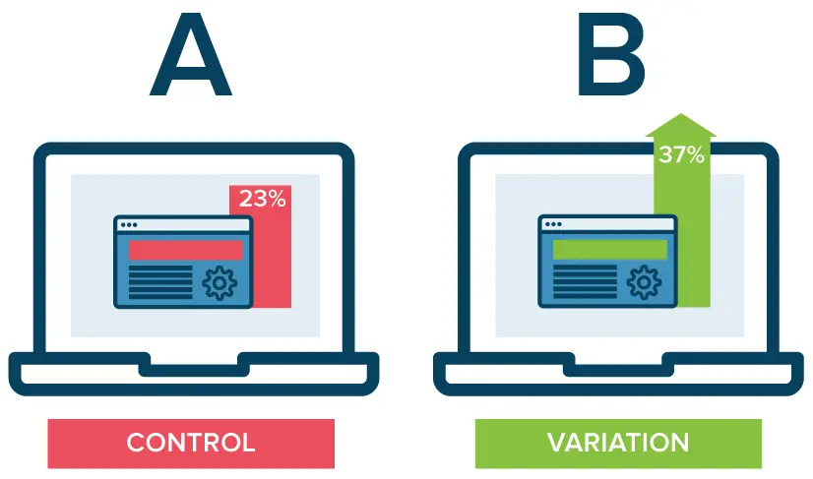
A/B Testing
A/B testing is essentially an experiment where two or more variants of a page are shown to users at random, and statistical analysis is used to determine which variation performs better for a given conversion goal.
It directly compares a variation against a current experience.
It lets you ask focused questions about changes to your website or app and then collect data about the impact of that change.

Slide 36
A/B Testing
Testing takes the guesswork out of website optimization.
It enables shift business conversations from "we think" to "we know".
You can ensure that every change produces positive results.

Slide 37
A/B Testing
The A/B test can be used as a stand-alone test or as an expansion of a prototype test.
The A/B test is a simple tool for testing two variants of a prototype simultaneously.
The test of the prototype usually answers a question with different characteristics.
This test is quite well suited to advance an existing prototype/MVP or to test a new variant in comparison with a basic prototype.
It is important to make it very clear before the test what is to be tested and compared.
Most users find it easier to give feedback when comparing two prototypes than when they are asked to comment on one prototype.

Slide 38
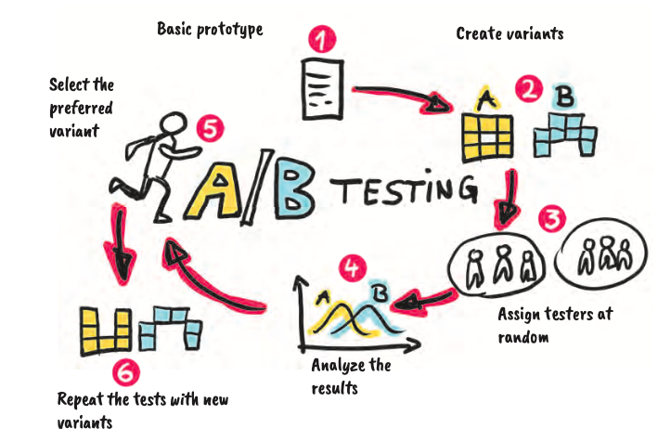
Procedure for A/B Testing
1. Define the basic prototype and decide who is to be the test group.
2. Consider variants of the prototype and make a decision for two of them to be compared with each other. Define key figures for what kind of testing is to be done.
3. For quantitative tests, assign the users at random and conduct the test.
4. Evaluate the results.
5. Use the preferred variant for improving the prototype.
6. Repeat the tests with new variants or perform another test for validation.

Slide 39
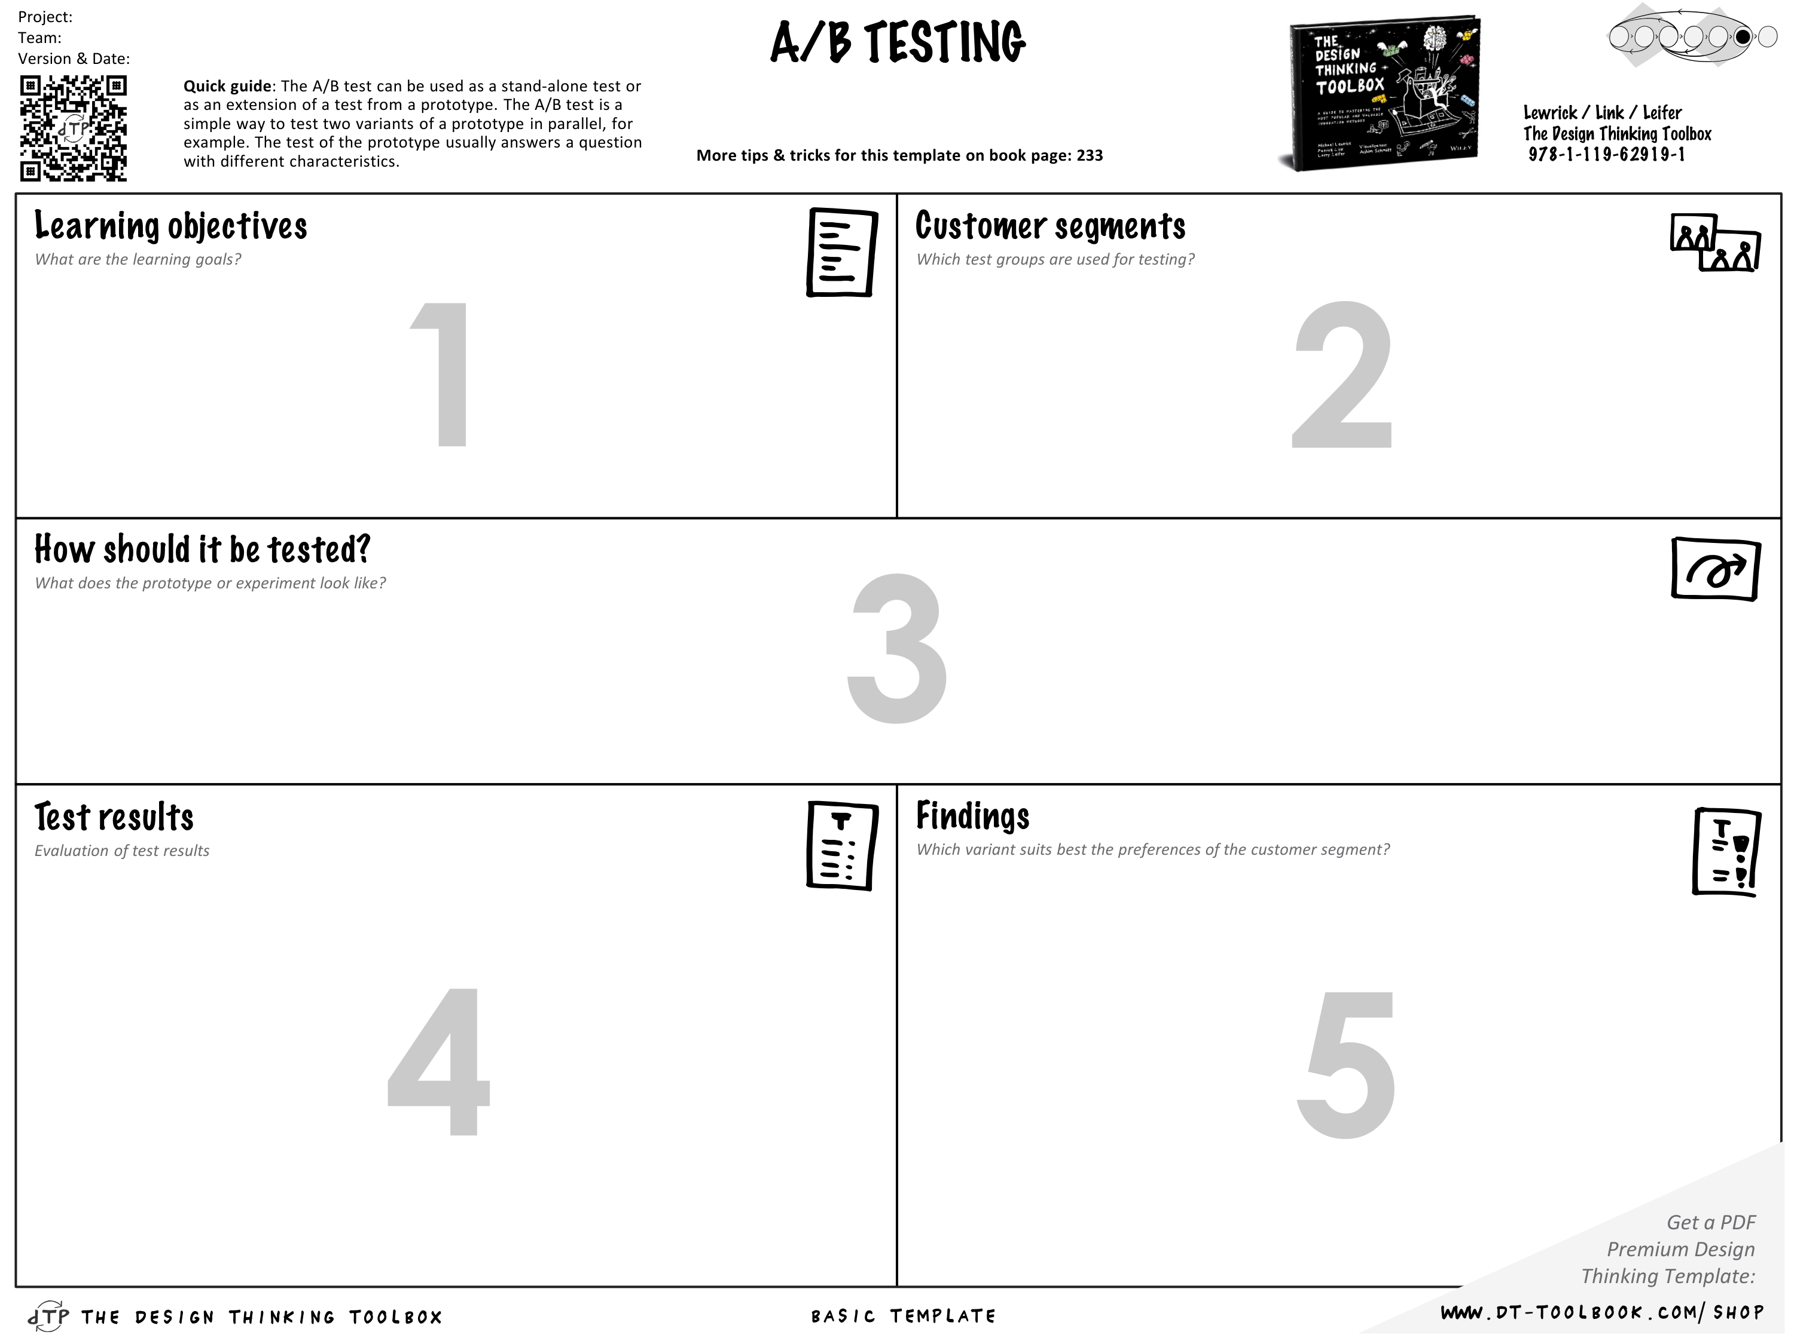
Tool for A/B Testing

Slide 40
Guerrilla Usability Testing
Section – 4

Slide 41
Guerrilla Usability Testing
Guerrilla usability testing is a quick and inexpensive way of testing a prototype or website with real users.
There is no formal recruitment or need for expensive research facilities. Here, participants are approached in public places and asked to take part in research.
These sessions normally last for only 10-15 minutes with a small incentive of a coffee or cake offered.
You would normally test between 6-12 users, but this will vary depending on what and where you are testing.
It is an agile way of testing a prototype or website to get high-level feedback or identify potential UX issues, at various stages in the project life cycle.

Slide 42
Steps to conduct Guerrilla Testing
Think about the best potential spots to find users.
Is it the closest coffee shop or might there be a better environment where your specific audience is more likely to be found?
How you speak, the words you use and how you behave will all have an effect on test subjects.
Test in different types of places and seek out a varied audience.

Slide 43
Guerrilla Usability Testing – Advantages & Disadvantages
Advantages | Disadvantages
Quick turn around | You may not get the right target audience
Inexpensive compared to formal testing | Sessions are short so you will lose some of the insights that you would get from formal user testing
Identify any UX barriers early in the process | Might not be appropriate for all types of websites or apps
This iterative testing works well in the agile project approach

Slide 44
UX Laws
Section – 5

Slide 45
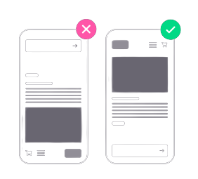

1.
Jakob’s Law
Users spend most of their time on other sites. This means that users prefer your site to work the same way as all the other sites they already know.
TAKEAWAYS
1
Users will transfer expectations they have built around one familiar product to another that appears similar.
2
By leveraging existing mental models, we can create superior user experiences in which the users can focus on their tasks rather than on learning new models.
3
When making changes, minimize discord by empowering users to continue using a familiar version for a limited time.
EXAMPLES
1
SNAPCHAT
2
GOOGLE
Founder: Jakob Nielson; Year: 2000; Law Type: Heuristic

Slide 46
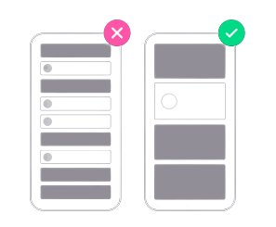
2.
Hick’s Law
The time it takes to make a decision increases with the number and complexity of choices.
TAKEAWAYS
1
Minimize choices when response times are critical to increase decision time.
2
Break complex tasks into smaller steps in order to decrease cognitive load.
3
Avoid overwhelming users by highlighting recommended options.
4
Use progressive onboarding to minimize cognitive load for new users.
5
Be careful not to simplify to the point of abstraction.
EXAMPLES
1
SLACKBOT
2
GOOGLE
Founder: William Edmund Hick and Ray Hyman; Year: 1952; Law Type: Heuristic

Slide 47
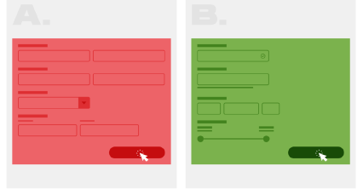
3.
Postel’s Law
Be liberal in what you accept, and conservative in what you do.
TAKEAWAYS
1
Be adopted to, flexible about, and tolerant of any of the various actions the user could take or any input they might provide.
2
Do in advance virtually anything in terms of input, access, and capability while providing a reliable and accessible interface.
3
The more we can do in advance and plan for in design, the more resilient the design will be.
4
Accept variable input from users, translating that input to meet your requirements, defining boundaries for input, and providing clear feedback to the user.
EXAMPLES
1
APPLE
2
GOOGLE
Founder: Jon Postel; Year: 1981; Law Type: Principle

Slide 48
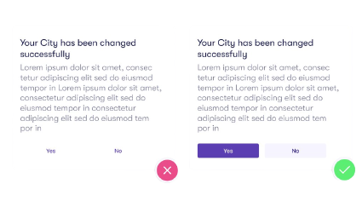
4.
von Restorff Effect
The von Restorff effect, also known as The Isolation Effect, predicts that when multiple similar objects are present, the one that differs from the rest is most likely to be remembered.
TAKEAWAYS
1
Make important information or key actions visually distinctive.
2
Use limit when placing importance on visual elements to avoid them competing with one another and to ensure noticeable items don’t get mistakenly identified as ads.
3
Don’t exclude those with a color vision deficiency or low vision by relying on color to communicate contrast.
EXAMPLES
4
Carefully consider users with motion sensitivity when using motion to communicate contrast.
1
DROPBOX
2
GMAIL
Founder: Hedwig von Restorff; Year: 1933; Law Type: Cognitive Bias

Slide 49
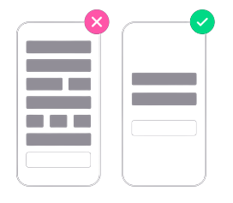
5.
Tesler’s Law
Tesler’s Law, also known as The Law of Conservation of Complexity, states that for any system there is a certain amount of complexity which cannot be reduced.
TAKEAWAYS
1
All processes have a core of complexity that cannot be designed away and therefore must be assumed by either the system or the user.
2
Ensure as much as possible of the burden is lifted from users by dealing with inherent complexity during design and development.
3
Take care not to simplify interfaces to the point of abstraction.
EXAMPLES
Click to Play: YouTube
1
APPLE
2
GMAIL
Founder: Larry Tesler, Computer Scientist at Xerox; Year: 1980; Law Type: Principle

Slide 50
Design Validation & Trade-offs
Section – 5

Slide 51
Design Validation & Trade-offs
Trade-offs in design refer to the process of evaluating and deciding between different options or approaches, each with its own set of advantages and disadvantages.
In design validation, key trade-offs involves;
Balancing the need for thorough testing to ensure quality with the constraints of time, cost, and resource availability.
It leads to decisions about the extent of test coverage, the level of test accuracy, and the choice of validation methods.
It potentially impacts the final product's reliability and time to market.

Slide 52
Common trade-offs
Sr. | Trade-offs | Description | Example
1 | Performance vs. Cost | Higher performance materials and components may improve functionality but often come at a higher price. | Instagram optimizes image and video compression for smooth performance, but higher compression reduces quality, impacting user experience. Reducing compression would improve quality but increase server and storage costs.
2 | Reliability vs. Time-to-Market | Extensive testing ensures reliability but can delay product launch. | Instagram introduces new features like Reels and Threads quickly to stay competitive, sometimes at the cost of initial bugs or glitches that are fixed post-launch.
3 | Innovation vs. Risk | Cutting-edge designs can differentiate a product but introduce potential failure points. | Instagram's algorithmic feed innovation boosts engagement but risks user reaction if it prioritizes ads or irrelevant content over user preferences.

Slide 53
Common trade-offs
Sr. | Trade-offs | Description | Example
4 | Manufacturability vs. Customization | Highly customized designs may not be easily scalable for mass production. | Instagram allows custom filters and effects, but fully customizable user interfaces would complicate app maintenance and consistency across devices.
5 | Safety vs. Weight/Size | Adding safety features may increase the weight or bulkiness of a product, impacting usability. | Adding content moderation and parental controls improves safety but increases app size and processing needs, which could slow down older devices.
6 | Regulatory Compliance vs. Design Freedom | Meeting industry regulations may limit design flexibility. | Instagram must comply with GDPR* and data privacy laws, which restrict certain tracking and personalization features that could enhance user experience.
*GDPR – General Data Protection Regulation

Slide 54
Heatmaps with Tools like Hotjar
Section – 6

Slide 55
Heatmaps with Tools like Hotjar
Heatmaps are visual representations of user interactions on a website or app.
They use color coding to indicate where users click, scroll, or move their cursor.
Red/orange areas show high activity.
Blue areas indicate less interaction.
Types of Heatmaps in Hotjar
Click Heatmaps – Show where users click the most (buttons, links, images).
Scroll Heatmaps – Indicate how far users scroll before leaving a page.
Move Heatmaps – Track where users move their cursor, which can indicate focus areas.
Engagement zone maps – show which parts of the page users interact with most.
Rage click maps – shows which page elements your users repeatedly click

Slide 56
Benefits of Using Heatmaps
Reaching important content or failing to see it.
Finding and using a page’s main links, buttons, opt-ins.
Getting distracted by non-clickable elements.
Experiencing issues across devices.
Heat maps help you make informed, data-based decisions for A/B testing, updating, or (re)designing your website.
Heat maps let you show team members and stakeholders what’s happening and get their buy-in more easily when changes are needed.

Slide 57
Thank you

